Slide 1
Schulich School of Engineering University of Calgary
Reimagining Student’s Experience
William (Bill) Rosehart, PhD, P.Eng, FCAE, FCSSE, FEIC
Dean and Professor
Schulich School of Engineering
University of Calgary
Email: rosehart@ucalgary.ca
October 2023

Slide 2
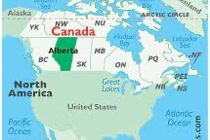
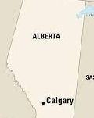
1

Slide 3
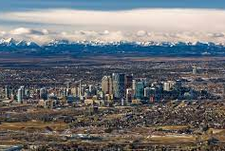
Calgary, Alberta
3

Slide 4
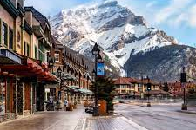
Banff National Park
4

Slide 5
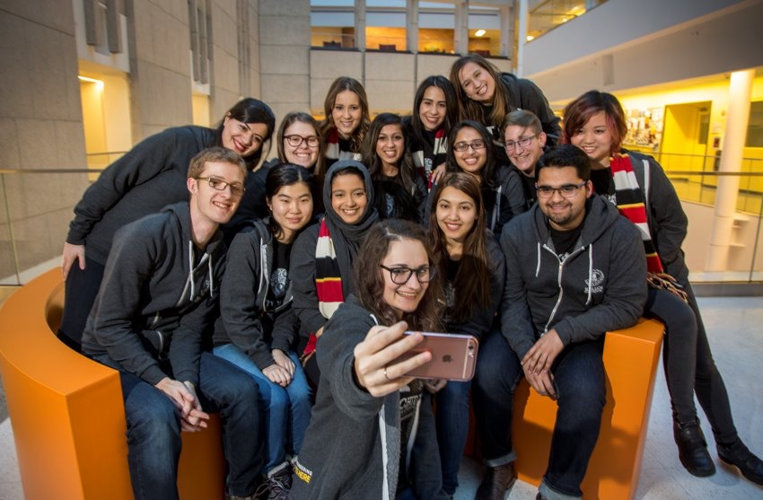
Schulich Momentum
5

Slide 6
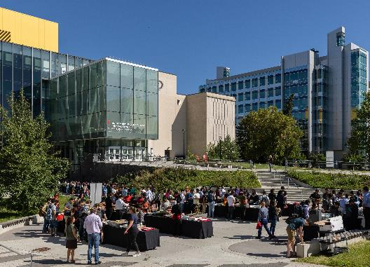
Schulich Strengths
Sustainability (Sostenibilidad)
Energy (Energía)
Digital Technology (Tecnología Digital)
Biomedical Engineering (Ingeniería Biomédica)
Advanced Materials and Manufacturing (Materiales y Manufactura Avanzados)
Engineering Education (Educación en Ingeniería)
5
Notes:
Schulich strengths are what we do, or need to do, exceptionally well. They’re what we are — or will become — known for. These strengths show up in our classrooms and in our labs. They permeate our student body and present themselves in research projects across all engineering disciplines.
20

Slide 7
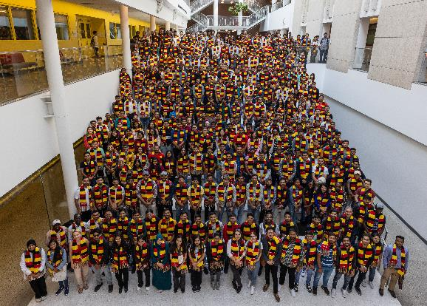
10 Years of Growth
In 2013, there were:
3,202 undergraduate students
982 graduate students
160 faculty members
In 2024, there are:
4,465 undergraduate students
2,289 graduate students
236 faculty members (including open searches)
En 2013, había:
3,202 estudiantes de pregrado
982 estudiantes de posgrado
160 miembros del cuerpo docente
En 2024, hay:
4,465 estudiantes de pregrado
2,289 estudiantes de posgrado
236 miembros del cuerpo docente (incluyendo búsquedas abiertas)
5
Notes:
20

Slide 8
Reimagining the Student Experience
Reimaginando la Experiencia Estudiantil

Slide 9
Schulich School of Engineering Undergraduate Programs
Biomedical Engineering
Chemical Engineering
Civil Engineering
Electrical Engineering
Energy Engineering
Engineering Physics
Geomatics Engineering
Mechanical Engineering
Oil & Gas Engineering (Energy Resources Engineering)
Software Engineering
Sustainable Systems Engineering
9

Slide 10
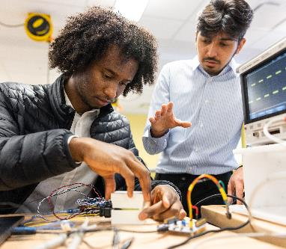
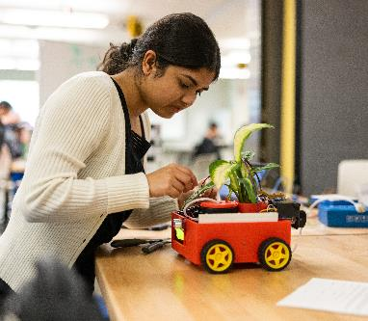
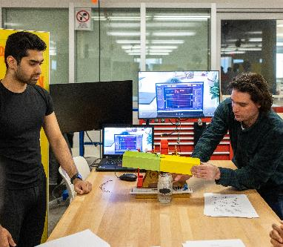
Schulich Studio: Integrated Learning Experiences
9
Notes:
Learn more here:
20

Slide 11
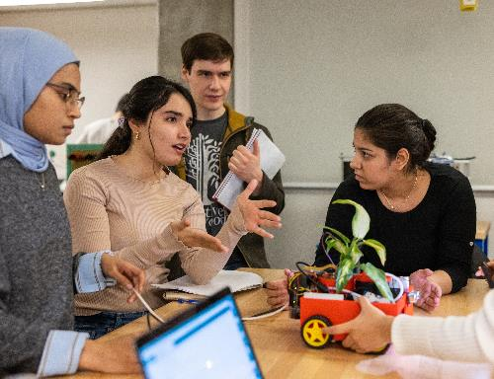
Schulich Studio: Integrated Learning Experiences
In the Studio we integrate traditional lecture, tutorial and laboratory experiences together (En los cursos se intengran lecciones magistrales, tutorías y sesiones de laboratiro.)
Increased focus on design projects and hands-on learning (Mayor enfoque en proyectos de diseño y aprendizaje práctico.)
Team-based and project-based learning (Aprendizaje basado en equipos y proyectos.)
Dedicated staff to support faculty members and teaching assistants (Personal dedicado para apoyar a los miembros del cuerpo docente y asistentes de enseñanza.)
9
Notes:
Learn more here:
https://schulich.ucalgary.ca/current-students/undergraduate/schulich-studio
20

Slide 12
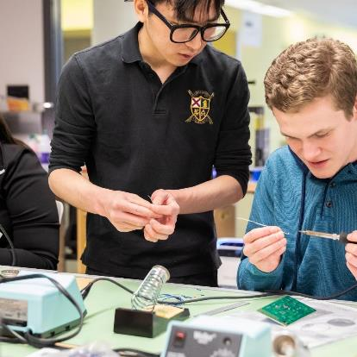
Micro-credentials (Microcredenciales)
Digital badges for workshops (Certificados digitales para resultados de aprendizaje en talleres)
Non-Credit Certificates in Leadership, Entrepreneurship, and Mental Health (Certificados sin créditos en Liderazgo, Emprendimiento y Salud Mental)
Normalmente requieren de 15 a 45 horas para completarse.
Se integran ciertas microcredenciales en los programas de los estudiantes (electrónica, taller de máquinas, programación)
9

Slide 13
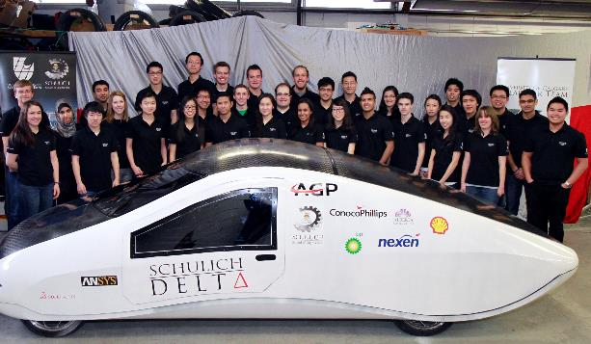
Teams and Clubs
Over 30 engineering student led teams and clubs
Más de 30 equipos y clubes liderados por estudiantes de ingeniería
Peer to peer teaching & learning
Enseñanza y aprendizaje entre compañeros
9
Notes:
Roughly 60 clubs and teams with 35 actively involved in Schulich
20

Slide 14
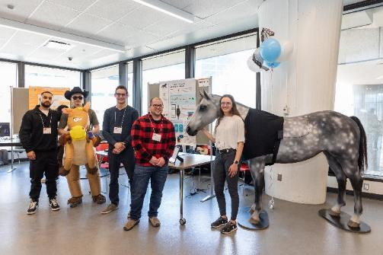
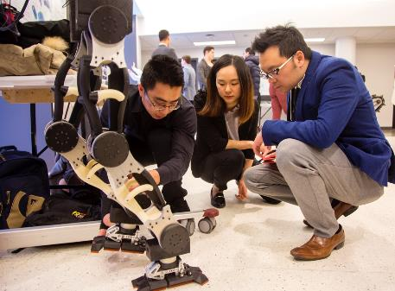
Engineering Design
Most of our Programs have a design course in each academic year
La mayoría de nuestros programas tienen un curso de diseño en cada año académico.
All students have a full year design course in their last year (capstone design)
Todos los estudiantes tienen un curso de diseño de un año completo en su último año (diseño de proyecto final).
Increased number of courses have design projects.
Un número mayor de cursos incluyen proyectos de diseño.
14
Notes:
The project gives students the opportunity to put all they’ve learned into practice. It’s also a unique chance for them to engage with the professional engineering community, working to solve challenges faced by industry or learning from mentors who are out in the field.
A design course does not develop a particular technical engineering skill/knowledge
Integrating Design Projects into course components (design projects versus laboratory experiences) – right experience, right level
20

Slide 15
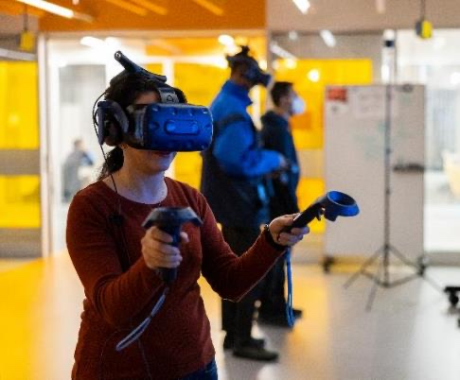
Maker Spaces
Drop-in rooms with technical support at no cost to use (Habitaciones de asistencia técnica sin cita previa sin costo alguno para usar):
Machine Shop
Electronics Shop
Wood Shop
3D Printers
3D Scanner Lab
Music Studios
Paint Booth
Welding
Robotics/IoT Lab
VR/AR Lab
Taller de Mecánica
Taller de Electrónica
Taller de Carpintería
Impresoras 3D
Laboratorio de Escaneo 3D
Estudios de Música
Cabina de Pintura
Soldadura
Laboratorio de Robótica/IoT
Laboratorio de Realidad Virtual/Aumentada
14
Notes:
20

Slide 16
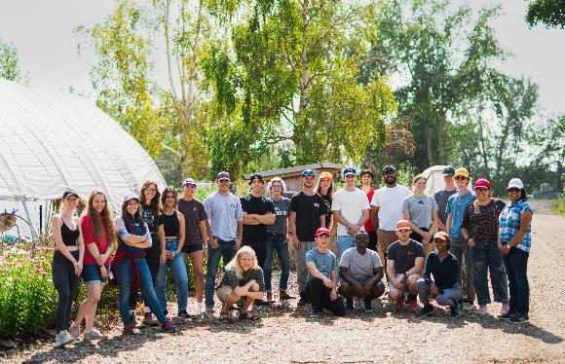
Embedded Field Trips:
Going beyond industry guest lectures
Yendo más allá de las conferencias de invitados de la industria.
Taking students to see engineering on site.
Llevando a los estudiantes a ver ingeniería en el sitio.
Notes:
Faculty manage of teaching spaces or a very good relationship with the registrar
20

Slide 17
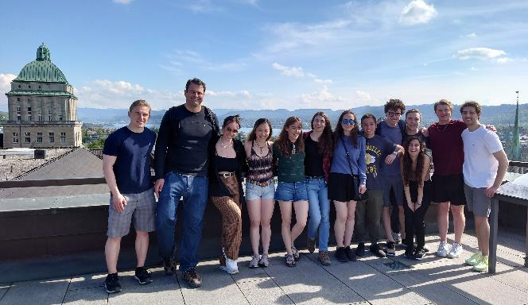
Global Engineering Experiences (Experiencias de Ingeniería Global)
Program specific trips, exploring engineering, industries, services and history
Viajes específicos del programa, explorando ingeniería, industrias, servicios e historia
Weeklong visits to see engineering outside of Canada
Visitas de una semana para ver la ingeniería fuera de Canadá
Takes place during “reading week”
Se lleva a cabo durante la "semana de lectura"
14
Notes:
Subsidized by the Schulich School of Engineering and its generous supporters.
Travel happens over reading week.
Locations previously travelled to: Berlin, Paris, Mexico, Netherlands, Silicon Valley, Sweden and more.
20

Slide 18
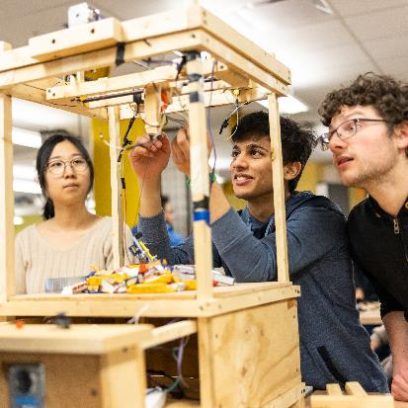
Disciplinary Knowledge and Tools (Conocimientos y herramientas disciplinarias)
Disciplinary knowledge and skills remain core to our programs
Los conocimientos y habilidades disciplinarias siguen siendo fundamentales en nuestros programas
Enhanced learning outcomes with increased integration of lectures, labs and tutorials and Design Projects
Resultados de aprendizaje mejorados con una mayor integración de conferencias, laboratorios, tutorías y proyectos de diseño.
14
Notes:
20

Slide 19
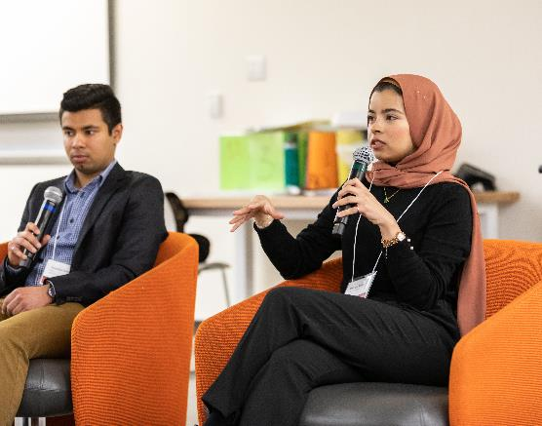
Beyond the Technical
Faculty certificates (Certificados para el cuerpo docente):
Leadership (Liderazgo)
Entrepreneurship (Emprendimiento)
Mental Health and Resilience (Salud Mental y Resiliencia)
Teamwork (partnership with Psychology)
Trabajo en equipo (en asociación con Psicología)
Maker Space digital badges
Certificados digitales para Maker Space
14
Notes:
<número>

Slide 20
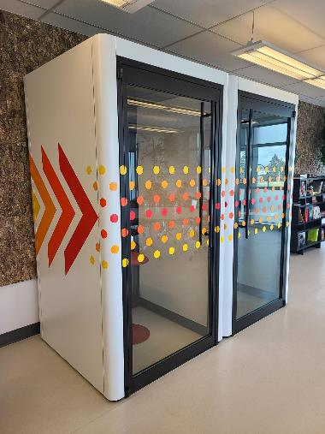
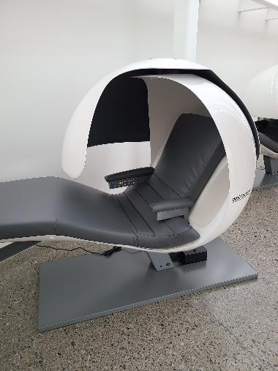
Spaces Beyond the Classroom and Lab
20
Notes:
Need to think very broadly about spaces students “need” to be successful.
<número>

Slide 21
Schulich Wellness
Dedicated wellness room, including
Yoga Classes
Meditation Classes
Music Classes
Games
Message Chairs
Sala de bienestar dedicada, incluyendo:
Clases de yoga
Clases de meditación
Clases de música
Juegos
Sillas de masaje
20
Notes:
The Certificate in Personal and Community Mental Well-Being supports student wellbeing, ensuring that every student who enters engineering has an opportunity to develop their resilience.
<número>

