Slide 1

UNIVERSITA’ DEGLI STUDI DI PERUGIA
Since 1308 we build the future

Slide 2


ACADEMIC CALENDAR
At the Università degli Studi di Perugia, semester start dates are usually different for each Department.
The first (or winter) semester usually begins between September and October and ends between December and January, with exams held in January/February. The second (or spring) semester usually begins in February/March and ends in May/June, with exams held in June/July.
The nomination must be sent by email at servizio.incoming@unipg.it indicating, for each student: name and surname, date and place of birth, gender, academic area of study, study level and personal email.
COURSE CATALOGUE – ECTS CATALOGUE
The ECTS guide provides all information on the University (Part 1) together with information on courses and modules (Part 2) and information on student life (Part 3). Please visit: https://www.unipg.it/en/ects
In Part 2 can visualized the Course Catalogue of all 14 Departments and a full list of modules taught in the following academic year.
Some modules are taught in English. It is strongly recommended the class attendance and for some courses it is mandatory.
At the end of each study unit, students must sit for the final examination. If a student does not take the final exam or if he/she fails it, no ECTS credits can be awarded.
Please note that our Degree Course Regulations do not allow us to award credits on the only basis of attendance.
ECTS System adopted: 1 CFU (Italian University Credit System) = 1 ECTS
All Incoming students attending the Department of Medicine and Surgery courses (in all Degree programs) during the A.Y. 2024/2025 must also submit a negative Tuberculin skin test certificate, issued within the last six months by an authorized structure. Otherwise, incoming students will not be able to attend the Department of Medicine and Surgery courses.

Slide 3

The deadline for 1st Semester (winter semester) and full-year applications is June 30th
The deadline for 2nd Semester (summer semester) applications is November 28th
As long as your University has an Exchange Agreement with Università degli Studi di Perugia, you can apply as an exchange student for a mobility period of study. You must be nominated by your Home University: please contact the competent office (Erasmus/International Office) at your University for the application procedures and requirements.
After being nominated by your Home University, you will receive an email from the Università degli Studi di Perugia with an access code that will allow you to start the on-line Application procedure.
Please note that the application is a unique session procedure where you will be asked to express your interest in the free of charge Italian Language Courses provided by Università degli Studi di Perugia.
You will also need to upload the following documents:
Transcript of Records indicating your previous academic results at your Home University (we will accept it in English or in your national language if it is readable);
Copy of your Identity Card (or Passport if you need an invitation letter for a Study Visa);
A passport-size photo in jpg format.
At the end of the Application procedure you will receive a confirmation email.
Online Learning Agreement
Università degli Studi di Perugia is connected to the EWP OLA system and for signature are used 14 account (one for each Department). You will be informed by email about your Department of enrollment and you will receive all the information that must be included in the OLA.
If your Home University is not connected to EWP OLA yet, Learning agreements in .pdf will be accepted by e-mail to servizio.incoming@unipg.it and the document must be signed by you and the Coordinator at Home University. The International The Departmental Erasmus Coordinator at the Università degli Studi di Perugia will revise your Learning agreement and you will receive the approved document or, if needed, specific comments and suggestions.

Slide 4

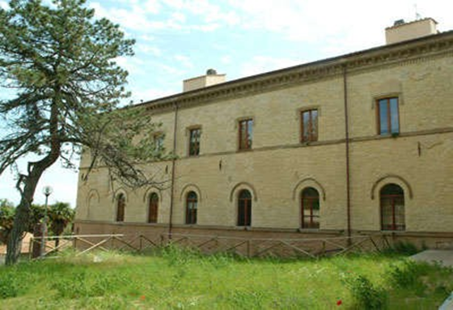
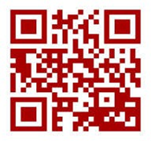
ITALIAN LANGUAGE COURSES
Incoming students must have at least an Italian A2 knowledge level before coming
to our University, since most of our classes are taught in Italian.
For students attending courses at the Department of Political Sciences
and Department of Veterinary Medicine and for students of the Nursing area
the language certification required is level Italian B1.
If you will take only classes held in English language, the required level is
English B1.
You must provide us by email the OLS (Online Linguistic Support) for Italian Language.
The credentials for the OLS platform will be released by your Home University.
The University Linguistic Centre (CLA) offers free of charge Italian Language Courses from A1 level (online) to C1/C2 levels. The Italian language course must be included in the OLA or learning agreement (no code is required).
Each student can attend only one course at a time and can indicate the willing of filling the corresponding box when completing the on-line Application form.
It is NOT mandatory to take the Italian language course, but if you enroll in the class the attendance is mandatory. The final exam for the Italian language levels B1/B2/C1/C2 will give you 4 ECTS per year.
Please note that these credits will only be allocated if the student has dutifully attended at least 75% of the course hours, after the final examination in face-to-face modality.
For additional information, please visit the following link http://www.cla.unipg.it/en/erasmus

Slide 5
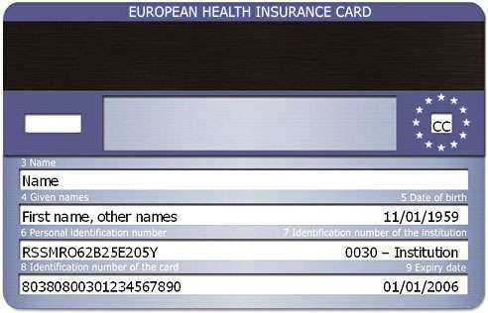

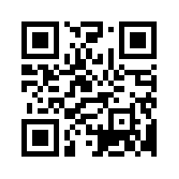
HEALTH
EU STUDENTS
EU students must bring their own European Health Insurance Card. This card entitles the holder to public medical assistance during his/her temporary stay (please note that the card cannot be used for private health care services). Medical assistance will be provided in accordance with the Italian legislation
NON-EU STUDENTS
Health insurance is an essential prerequisite to obtain a Permit of stay and a Study visa.
Non-EU students should verify that they are getting the correct health insurance coverage by contacting the Italian Consulate/Embassy in their home country.
However, once non-EU students have obtained their permit of stay they can decide to receive full medical assistance by registering to National Health Service (SSN) at the ASL (Local Health Agency) that provides coverage until the 31st December of each year in which the registration has been made. Passport, permit of stay and personal income tax information are needed in order to apply.
FACILITIES FOR SPECIAL NEEDS STUDENTS
The University guarantees support and assistance to special needs students during their university career through the adoption of a series of services and initiatives coordinated and monitored by a Delegate appointed by the Rector. Furthermore, each Department has a Delegate that offers guidance and support to students in special needs.
Please visit:
https://www.unipg.it/en/international-students/general-information/facilities-for-special-needs-students
For basic medical services including visits, prescriptions, doctor referrals to specialists, and follow-up, please visit: https://www.unipg.it/en/international-students/general-information/medical-facilities

Slide 6


The application for access to all the degree courses for international students applying for visas and residing abroad, must take place through a prior university pre-enrollment procedure
https://www.universitaly.it/first-steps
In the application, you must indicate Università degli Studi di Perugia and choose the degree programme you were nominated for the mobility.
You will also need to specify the Italian Embassy / Consulate where you will apply for an entry visa to Italy.
The invitation letter will be issue only after the OLA/Learning agreement will be approved by all parties and you will complete the registration in Universitaly portal. A copy will be send by email to you and to the Embassy / Consulate you have specified. We suggest you register and provide us all the necessary documents as soon as possible in order to speed up the visa issuing process.
The Visa candidates must follow the instruction of the Italian Embassy / Consulate located in their Country, in order to be informed about the appointment for Visa.
STUDY VISA
Non-EU students must obtain a study Visa and should directly contact the Italian Consulate or Embassy in their Home Country to gather information on the procedure to obtain the Visa. We recommend starting the procedure as soon as possible. For more information visit: http://vistoperitalia.esteri.it/home/en
When applying for a Visa, students must provide the Invitation letter (issued by the Università degli Studi di Perugia after the approval of the Learning Agreement and the registration in Universitaly portal).

Slide 7
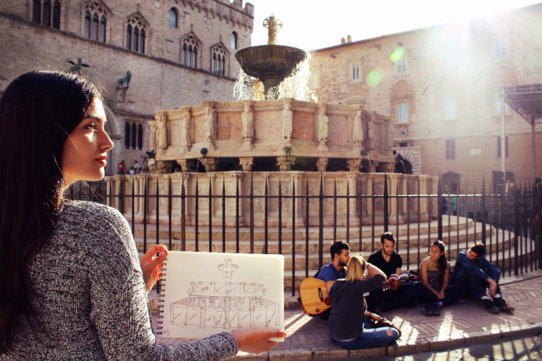

PERMIT OF STAY
Non-EU students who wish to study in Perugia for more than 3 months must apply for a permit of stay (in Italian: “Permesso di Soggiorno”) within 8 days from their arrival in Perugia. The "Permesso di soggiorno” application pack (a yellow-striped envelope) is available at any post office branch with a “Sportello Amico” desk.
The application pack must be properly filled out with your personal data. An English translation of the notes indicated in the Application can be found at this link: https://www.portaleimmigrazione.it/docs/Mod_209/MOD_209_Multilingue.pdf
In order to get your Permit of Stay, within 8 days from your arrival, the application pack has to be presented at the post office together with the following documents:
A copy of your Visa for study;
A photocopy of a currently valid passport along with the original document;
A photocopy of health insurance policy, valid throughout Italy and for the entire period of stay requested in the permit.
The application pack costs around €100,00 (to be paid directly to the post office) for the issue of the electronic permit and € 16,00 for the revenue stamp (this stamp, called “marca da bollo”, can be purchased at any local tobacconist shop).
Each student will be provided with the credentials to verify the progress of the application procedure at http://questure.poliziadistato.it/stranieri/ and will get their first scheduled appointment at the Questura. The documents that the student must bring with him/her to the appointment are: 4 identical, recent and passport-size color photos (white background), the original valid passport, the postal office receipt.
The Questura is located in
via del Tabacchificio n. 21
06127 PERUGIA
Tel: +39 075 506 2541.
Location: https://goo.gl/maps/b9W3h4yaRqL2
A branch Office of the Questura is located at Piazza Fortebraccio n. 4 within the premises of the Università per Stranieri (Palazzo Gallenga)
HOW TO REQUEST YOUR FISCAL CODE
The fiscal code can be requested online at the Agenzia delle Entrate, the local revenue office.
You can get an appointment through the Agenzia delle Entrate website: https://prenotazioneweb.agenziaentrate.gov.it/PrenotazioneWeb/prenotazione.action

Slide 8
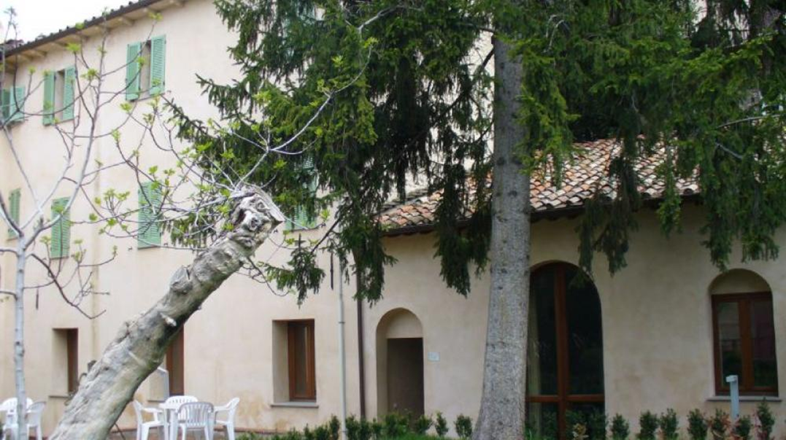
Cafeterias
Incoming Students have the possibility to benefit from the services of the Adisu cafeterias, where food quality is a top priority, whether it is local or international cuisine that is being served.
In addition to these, three other cafeterias and seven restaurants have signed an agreement with the University of Perugia at its branch campuses in Terni, Assisi, Foligno and Narni. Within these facilities, both full meals and single portions can be bought at reduced prices.
For a complete list of all Adisu cafeterias, please visit:
https://www.adisu.umbria.it/ristorazione-ristoranti-grid
In order to be able to take advantage of student cafeterias and special prices, Incoming Students must possess a Mensa (Cafeteria) QR code. To obtain this QR code, students must request it to the Adisu (Agenzia per il Diritto allo Studio Universitario dell’Umbria)
Cafés
Adisu also manages 3 cafés respectively located at La Casa dello Studente in Via Innamorati and at the Department of Engineering. The 100dieci café, located near the main cafeteria, is not only a meeting point where students can gather for a coffee or a quick meal but also a place where they can study or hold cultural events.
For a complete list of all Adisu cafés, please visit:
https://www.adisu.umbria.it/ristorazione-ristoranti-grid

Slide 9


ESN in Perugia
The offer of the ESN Perugia section (https://perugia.esn.it/) focuses on four topics: welcoming, accommodation, integration and support. Each topic includes more activities, called projects.
Going into detail, the welcoming service is directed to all the incoming students through the #BeFriend and Welcome Days projects. Both projects have as main goal to establish a direct relationship with the Erasmus students, understanding their needs and supporting them throughout the whole period of studies in Perugia.
This is followed by the accommodation service - through the project Erasmus Accommodation - a useful tool which facilitates the search for a house. It is not easy to find a place to stay in a new city, that is why ESN Perugia helps you with a direct and safe search for an accommodation.
Erasmus means knowing and relating, and our organisation knows how to create meeting events for the students: Italian Language Lab, NEG, ICE, SocialErasmus, ExchangeAbility, TripUs and Enjoy Your Erasmus are just a few of the many projects which are aimed to enrich your experience here in Perugia.
- E-mail: perugia@esn.it - Pec: esnperugia@pec.it - Intagram: @esnperugia - Facebook: ESN Perugia - Site: www.perugia.esn.it - App: ESN Perugia App

Slide 10
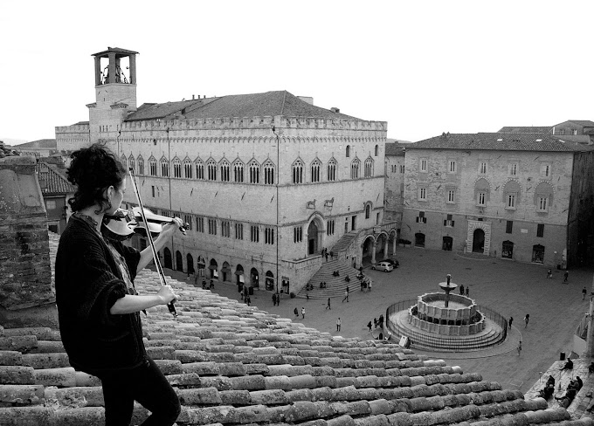
STUDENT FACILITIES
IT Laboratories
The Università degli Studi di Perugia Departments have one or more IT labs which are freely available to our students. For more information on IT lab locations and opening times please contact individual Departments.
Study Rooms and Social Gathering Student-Managed Spaces
(SASA – Spazi di Aggregazione e Studio in Autogestione)
Please note that these facilities are directly managed by the students. For information on how to access the study rooms with QR Code, please consult the Facebook page: https://www.facebook.com/aulestudiounipg
Libraries
Our Library Service Center (Centro Servizi Bibliotecari - CSB) manages several libraries located throughout Perugia and Terni. For more information about our libraries, please visit:
https://www.csb.unipg.it/organizzazione/strutture-bibliotecarie/sedi-e-orari
We also provide an online resource catalogue that can be accessed directly via the following website:
http://www.csb.unipg.it/risorse

Slide 11
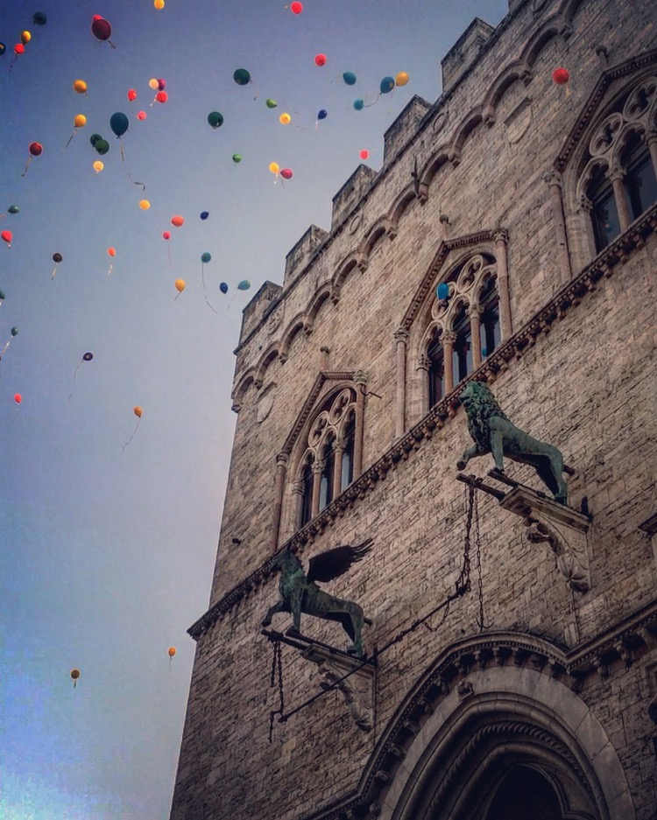
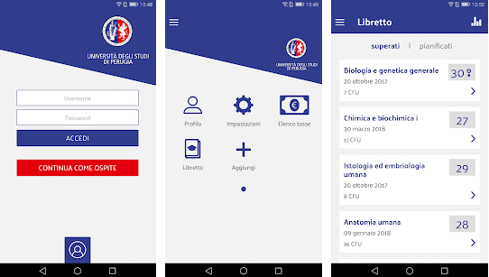
Our APP
My UniPG
Download the app on google play or app store
By entering with their UNIPG credentials (that we will be created for you by the Welcome Office, prior to your arrival), enrolled students will have access to the personal information of the online secretary and in particular will have the opportunity to: view the exam calendar, book the exams, fill in the teaching evaluation questionnaires, consult the information of the Uuniversity booklet and the status of the career, receive communications from the University, watch the progress of the academic career: exams taken, study plan, average of grades and credits.

Slide 12
INTERNATIONAL RELATIONS AREA - WELCOME OFFICE
Arrival documents in Perugia and departure tickets at the end of the mobility must be send by email at servizio.incoming@unipg.it in order to complete the procedure related to your exchange period.
If you will arrive or depart from Perugia by car, please come in person at the Welcome Office (Palazzo Murena, Piazza dell’Università, n. 1) in the opening hours: Monday, Wednesday and Friday morning from 11 a.m. to 1 p.m. and Tuesday afternoon from 3 p.m. to 5 p.m.
For any inquire you can contact the Welcome Office by email at: servizio.incoming@unipg.it

Slide 13
Location of the Welcome Office on a map https://goo.gl/maps/moF4NeoQDDx
Tel: +39 075 585 2024 - +39 075 585 2168 - +39 075 585 2072 Fax: +39 075 585 2352
e-mail: servizio.incoming@unipg.it

